Slide 1
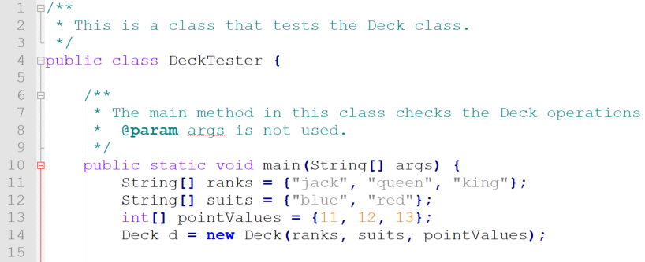
Call Stack
Level | Class | Method | Line

Slide 2
Call Stack
Level | Class | Method | Line
1 | DeckTester | main | 11

Slide 3
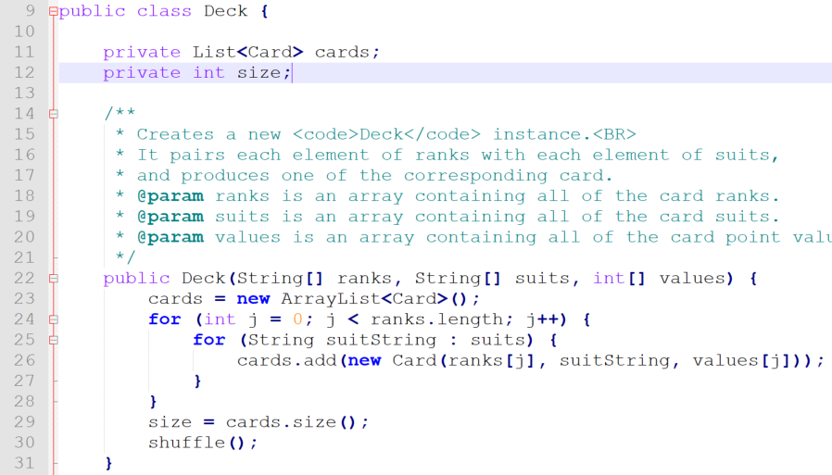
Call Stack
Level | Class | Method | Line
1 | DeckTester | main | 14
2 | Deck | <init> | 23

Slide 4
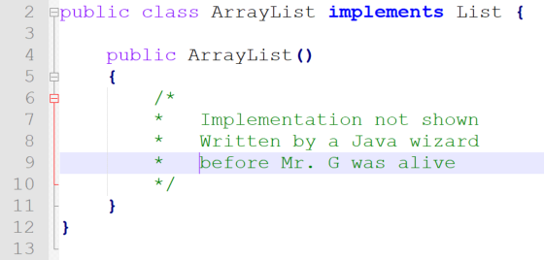
Call Stack
Level | Class | Method | Line
1 | DeckTester | main | 14
2 | Deck | <init> | 23
3 | ArrayList | <init> | ??

Slide 5
Call Stack
Level | Class | Method | Line
1 | DeckTester | main | 14
2 | Deck | <init> | 23
3 | ArrayList | <init> | ??

Slide 6
Call Stack
Level | Class | Method | Line
1 | DeckTester | main | 14
2 | Deck | <init> | 23

Slide 7
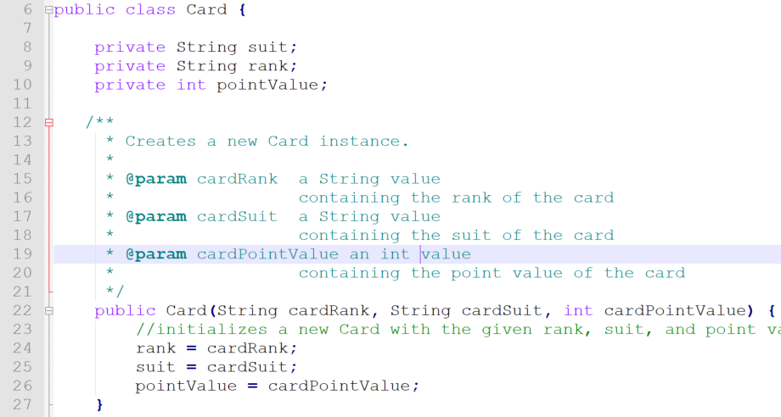
Call Stack
Level | Class | Method | Line
1 | DeckTester | main | 14
2 | Deck | <init> | 26
3 | Card | <init> | 24

Slide 8
Call Stack
Level | Class | Method | Line
1 | DeckTester | main | 14
2 | Deck | <init> | 26

Slide 9
Call Stack
Level | Class | Method | Line
1 | DeckTester | main | 14
2 | Deck | <init> | 29
3 | ArrayList | size | ??

Slide 10
Call Stack
Level | Class | Method | Line
1 | DeckTester | main | 14
2 | Deck | <init> | 29

Slide 11
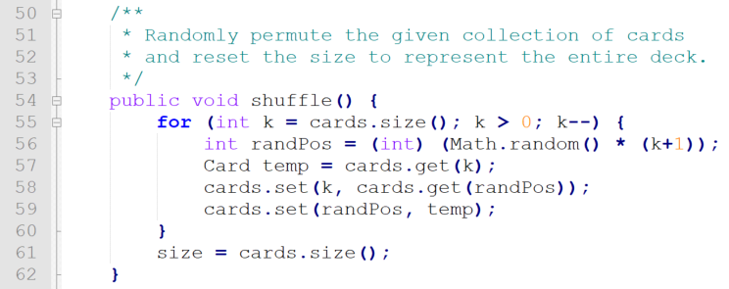
Call Stack
Level | Class | Method | Line
1 | DeckTester | main | 14
2 | Deck | <init> | 30
3 | Deck | shuffle | 55

Slide 12
Call Stack
Level | Class | Method | Line
1 | DeckTester | main | 14
2 | Deck | <init> | 30
3 | Deck | shuffle | 55
4 | ArrayList | size | ??

Slide 13
Call Stack
Level | Class | Method | Line
1 | DeckTester | main | 14
2 | Deck | <init> | 30
3 | Deck | shuffle | 56

Slide 14
Call Stack
Level | Class | Method | Line
1 | DeckTester | main | 14
2 | Deck | <init> | 30
3 | Deck | shuffle | 55
4 | Math | random | ??

Slide 15
Call Stack
Level | Class | Method | Line
1 | DeckTester | main | 14
2 | Deck | <init> | 30
3 | Deck | shuffle | 57

Slide 16
Call Stack
Level | Class | Method | Line
1 | DeckTester | main | 14
2 | Deck | <init> | 30
3 | Deck | shuffle | 55
4 | ArrayList | get | ??

Slide 17
